Slide 1
URBAN GROOVE We make it better together Indo-Chinese Cuisine
Case Study

Slide 2
Database Design steps:
Requirement Analysis
Conceptual Model
Logical Model
Physical Model
Implementation of Physical Model
Constraint Testing

Slide 3
REQUIREMENT ANALYSIS

Slide 4

COMPANY OVERVIEW
Urban-Groove is a leading Restaurant of Indian and Chinese cuisine. Over the years, Urban-Groove has mastered the art of using spice to give one’s taste buds the best food experience. The demand for this unique food has led us to take this experience to Toronto. Urban-Groove was established in Scarborough in 2005. And now Urban-Groove has preserved the culinary traditions and served as one of the most outstanding Ambassadors of Indian and Chinese Cuisine.

Slide 5
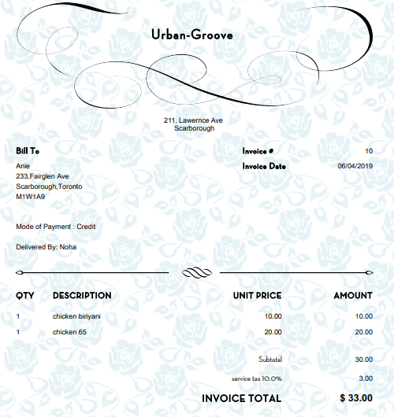
Customer Invoice

Slide 6
LOGICAL MODEL
Normalization

Slide 7
Un-Normalized Form Un-normalized form is a preparatory stage of the normalisation process allowing us to create a structured frame, representative of a piece of organisational data such as a form or document ( invoice, report, purchase order etc.)
(customer_id, first_name,middle_initial, last_name, phone_number, email_id, customer_house_no,area, zip_code, invoice_date, mode_of_payment, order_status, order_id, order_quantity, item_id, item_name, price, item_cusine,item_type, del_employee_id,first_name,last_name, del_ph_no, , hire_date, sex, salary, social_insurance_num)

Slide 8
Entity and Attributes Identification
ORDER
order_id, invoice_date ,mode_of_payment, order_status, user_id, del_person_id
CUSTOMER
customer_id, first_name, middle_initial, last_name, phone_number, email_id, customer_house_no,area, zip_cod)
ITEM
item_id, item_name, price, item_cusine
DELIVERY
del_employee_id, first_name, last_name,del_ph_no, hire_date, sex, salary, social_insurance_num

Slide 9
1NF A database is in first normal form if it satisfies the following conditions: 1) Contains only atomic/single values 2) There are no repeating groups 3) A primary key is assigned to the table
Identifying the Primary key:
Primary key- Customer_Id, Order_id,item_id
(customer_id, first_name,middle_initial, last_name, phone_number, email_id, customer_house_no,area, zip_code , invoice_date, mode_of_payment, order_status, order_id, order_quantity, item_id, item_name, price, item_cusine, item_type, del_employee_id,first_name,last_name, del_ph_no)

Slide 10
2NF A relation is in second normal form if it is in 1NF and every non key attribute is fully functionally dependent on the primary key.
Removing partial dependencies:
ORDERS (order_id, invoice_date, mode_of_payment , order_status, customer id, first_name, middle_initial, last_name, phone_no, email_id, customer_house_no, area, zip_code, del_employee_id,first_name,last_name, del_ph_no)
ITEM(item_id, item_name, price, item_cusine, item_type)
ORDER_DETAILS (order_id, order_quantity, item_id)

Slide 11
3NF A relation is in third normal form if it is in 2NF and no non key attribute is transitively dependent on the primary key.
Removing transitive dependencies:
ORDER_DETAILS (order_id, order_quantity, item_id)
ORDERS (order_id, invoice_date, mode_of_payment, order_status, customer_id, del_employee_id)
CUSTOMER (customer id, first_name, middle_initial, last_name, phone_no, email_id, customer_house_no, area_id)
ITEM (item_id, item_name, price, item_cusine, item_type)
DELIVERY (del_employee_id,first_name,last_name, del_ph_no)
AREA (area_id, zip_code)

Slide 12
CONCEPTUAL DESIGN

Slide 13
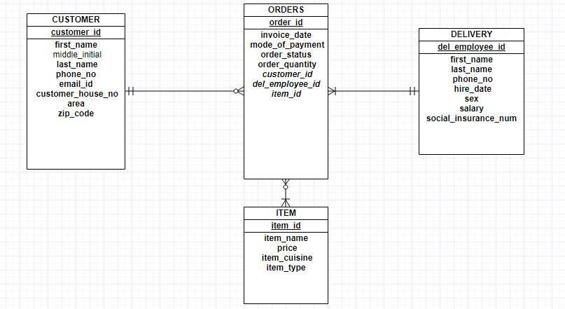
Entity-Relationship Diagram

Slide 14
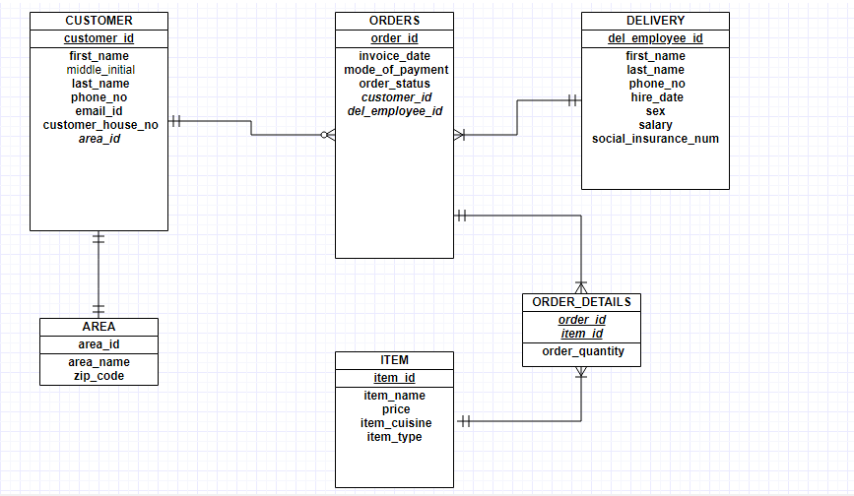
ER diagram solving Many to Many relationships

Slide 15
PHYSICAL MODEL

Slide 16
ATTRIBUTE | DATA TYPE | LENGTH | NULL CAPABLE | CONSTRAINTS
order_id | Integer |  | N | Unique identifier
invoice_date | DATE |  | N | Should be less than current date. Default- current date
order_status | BOOLEAN | 1 | N | 0-CANCELLED CONFIRM
customer_id | Varchar | 5 | N | Foreign key
del_employee_id | Varchar | 5 | N | Foreign key

Slide 17
IMPLEMENTING PHYSICAL MODEL
create database RESTAURANT; USE RESTAURANT;
CREATE TABLE ORDERS(
order_id INT PRIMARY KEY,
invoice_date DATE NOT NULL DEFAULT GETDATE() CHECK (invoice_date<=GETDATE()),
mode_of_payment VARCHAR(6) NOT NULL CHECK (mode_of_payment IN ('CASH','DEBIT','CREDIT')),
order_status BIT NOT NULL DEFAULT 1,
customer_id INT NOT NULL REFERENCES CUSTOMER(customer_id),
del_employee_id INT NOT NULL REFERENCES DELIVERY(del_employee_id))

Slide 18
Business Constraints
Id of customer table is unique identifier.
Email id in customer table must contain ‘@’ and ‘ . ‘
Area id as foreign key
Delivery person id is unique identifier in delivery table
ID in order table is unique identifier
Date in order should not be more than current date
Date in order has Default value as current date
Order status must be 0 or 1 where 0 is CANCELLED and 1 is CONFIRM

Slide 19
Continued…
CustomerID and DelEmployeeID are the foreign key
Zip code must start with ‘M’
Price in item must be more than 0
Item cuisine must be in ‘CHINESE’, ‘SOUTH INDIAN’, ‘NORTH INDIAN’, ‘KEBAB’
Item type must be in ‘V’,’N’
Order quantity in order details table must be more than 0
OrderID and ItemID are the foreign key

Slide 20
Inserting data into Tables
AREA TABLE:
insert into AREA Values (111,'Kingston Rd','Scarborough','M1A2N7')
insert into AREA Values (122,'Lawrence Ave E','North York','M4A2S8')

Slide 21
CUSTOMER TABLE:
insert into CUSTOMER values ('C1100','ANIE','','JOSE','6488920120','aniejose23@gmail.com',121,150)
ITEM TABLE:
insert into ITEM values ('IT200','chicken briyani',10.00,'South Indian','N')
insert into ITEM values ('IT120','chicken 65',20.00,'kebab','N')

Slide 22
DELIVERY TABLE:
insert into DELIVERY values ('D1157','Noah','zen',4486920900)
ORDERS TABLE:
insert into ORDERS values (10,'04/06/2019','Credit',1,'C1100','D1157')
insert into ORDERS values (283,'11/21/2018','cash',1,'C1123','D1122')

Slide 23
ORDER DETAILS TABLE:
insert into ORDER_DETAILS values (10,'IT200',1)
insert into ORDER_DETAILS values (10,'IT120',1)
insert into ORDER_DETAILS values (283,'IT023',4)

Slide 24
Constraint Testing
Zip code must start with ‘M’
insert into AREA Values (150,'Silver Blvd','Scarborough','R1B2M9')

Slide 25
Email id in customer table must contain ‘@’ and ‘ . ‘
insert into CUSTOMER values ('C1123','RANCH','M','NICK','6148899832','ranchnickgmailcom',76,111)

Slide 26
Area id as foreign key
insert into CUSTOMER values ('C1179','SAI','','BALA','4486920127','saibala@gmail.com',121,222)

Slide 27
Item type must be in ‘V’,’N’
insert into ITEM values ('IT023','paneer fried rice',10.00,'chinese','T')

Slide 28
Date in order should not be more than current date
insert into ORDERS values (10,'10/06/2019','Credit',1,'C1321','D1157')

Slide 29
Order quantity in order details table must be more than 0
insert into ORDER_DETAILS values (10,'IT023',0)

Slide 30
THANK YOU

